Slide 1
Vision Assist:
TEAM : Neural Nexus (ADIT Calicut)

Slide 2
AGENDA
Brief Overview of the Project
Problem Statement
Who are the End-Users
Future Updates
Modelling
Conclusion & Insights

Slide 3
Project Overview
Vision Assist is an AI-powered mobile application designed to enhance the independence, safety, and quality of life for visually impaired individuals.
The app leverages technologies such as object detection, facial recognition and natural language processing to provide real-time assistance.
Key features include object identification, spatial description, facial recognition, activity recognition, voice feedback, text reading, and real-time currency recognition.

Slide 4
Problem Statement
Visually impaired individuals face significant challenges in navigating their environment, identifying objects, recognizing faces, and performing everyday tasks.
Traditional aids like canes and guide dogs have limitations and do not fully address these challenges.
There is a need for a comprehensive, user-friendly, and accessible solution that integrates multiple functionalities to assist visually impaired individuals.

Slide 5
End-Users
The primary end-users of Vision Assist are visually impaired individuals seeking to enhance their independence and safety.
Secondary end-users include caregivers and family members who support visually impaired individuals, as well as organizations that provide services to the visually impaired community.

Slide 6
Future Updates
Navigation Assistance: Integrate turn-by-turn navigation with obstacle avoidance to guide users safely.
Indoor Navigation: Use Bluetooth beacons or Wi-Fi positioning for accurate navigation in indoor environments like malls and airports.
Expanded Language Support: Provide support for multiple languages for voice feedback to cater to a global audience.
Crowdsourced Hazard Reporting: Enable users to report and share hazards, creating a community-driven safety database.
Enhanced Depth Estimation: Incorporate dual-camera smartphones or external sensors for more accurate depth estimation and obstacle detection.

Slide 7
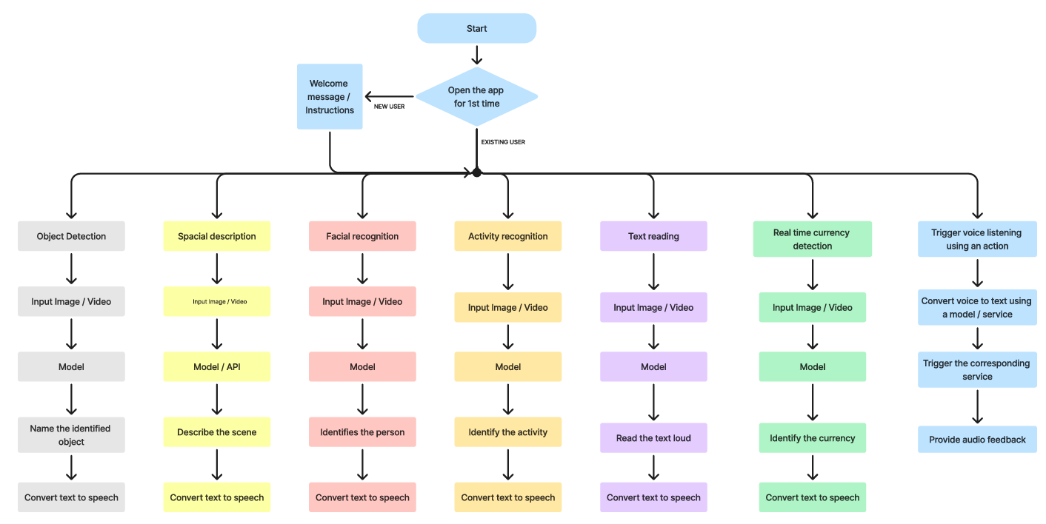
Modelling

Slide 8
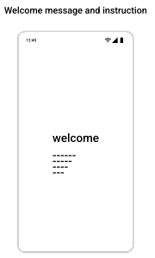
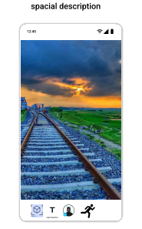
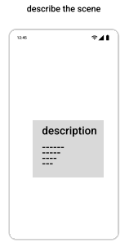
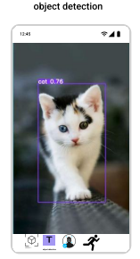
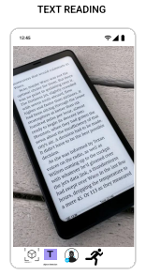
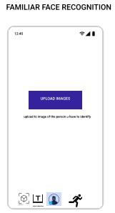
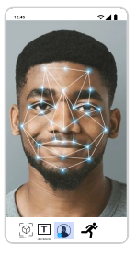
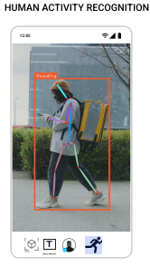
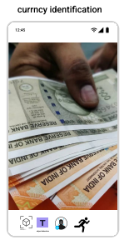

Slide 9
Conclusion & Insights
Vision Assist aims to bridge the gap between traditional aids and modern technology, offering a comprehensive solution to enhance the independence and safety of visually impaired individuals.
By integrating advanced AI and computer vision technologies, Vision Assist provides real-time assistance in various aspects of daily life, significantly improving the quality of life for its users.
Continuous improvements and user feedback will drive the evolution of Vision Assist, ensuring it remains an essential and effective tool for visually impaired individuals.

